Slide 1
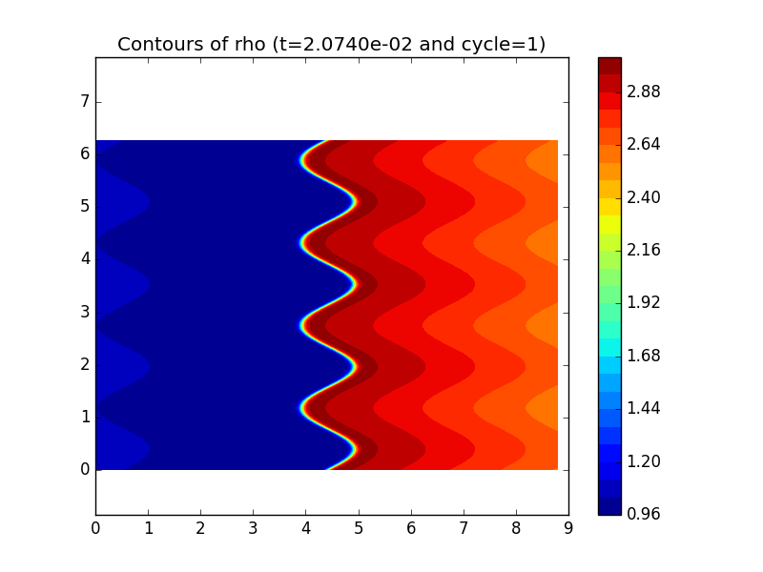
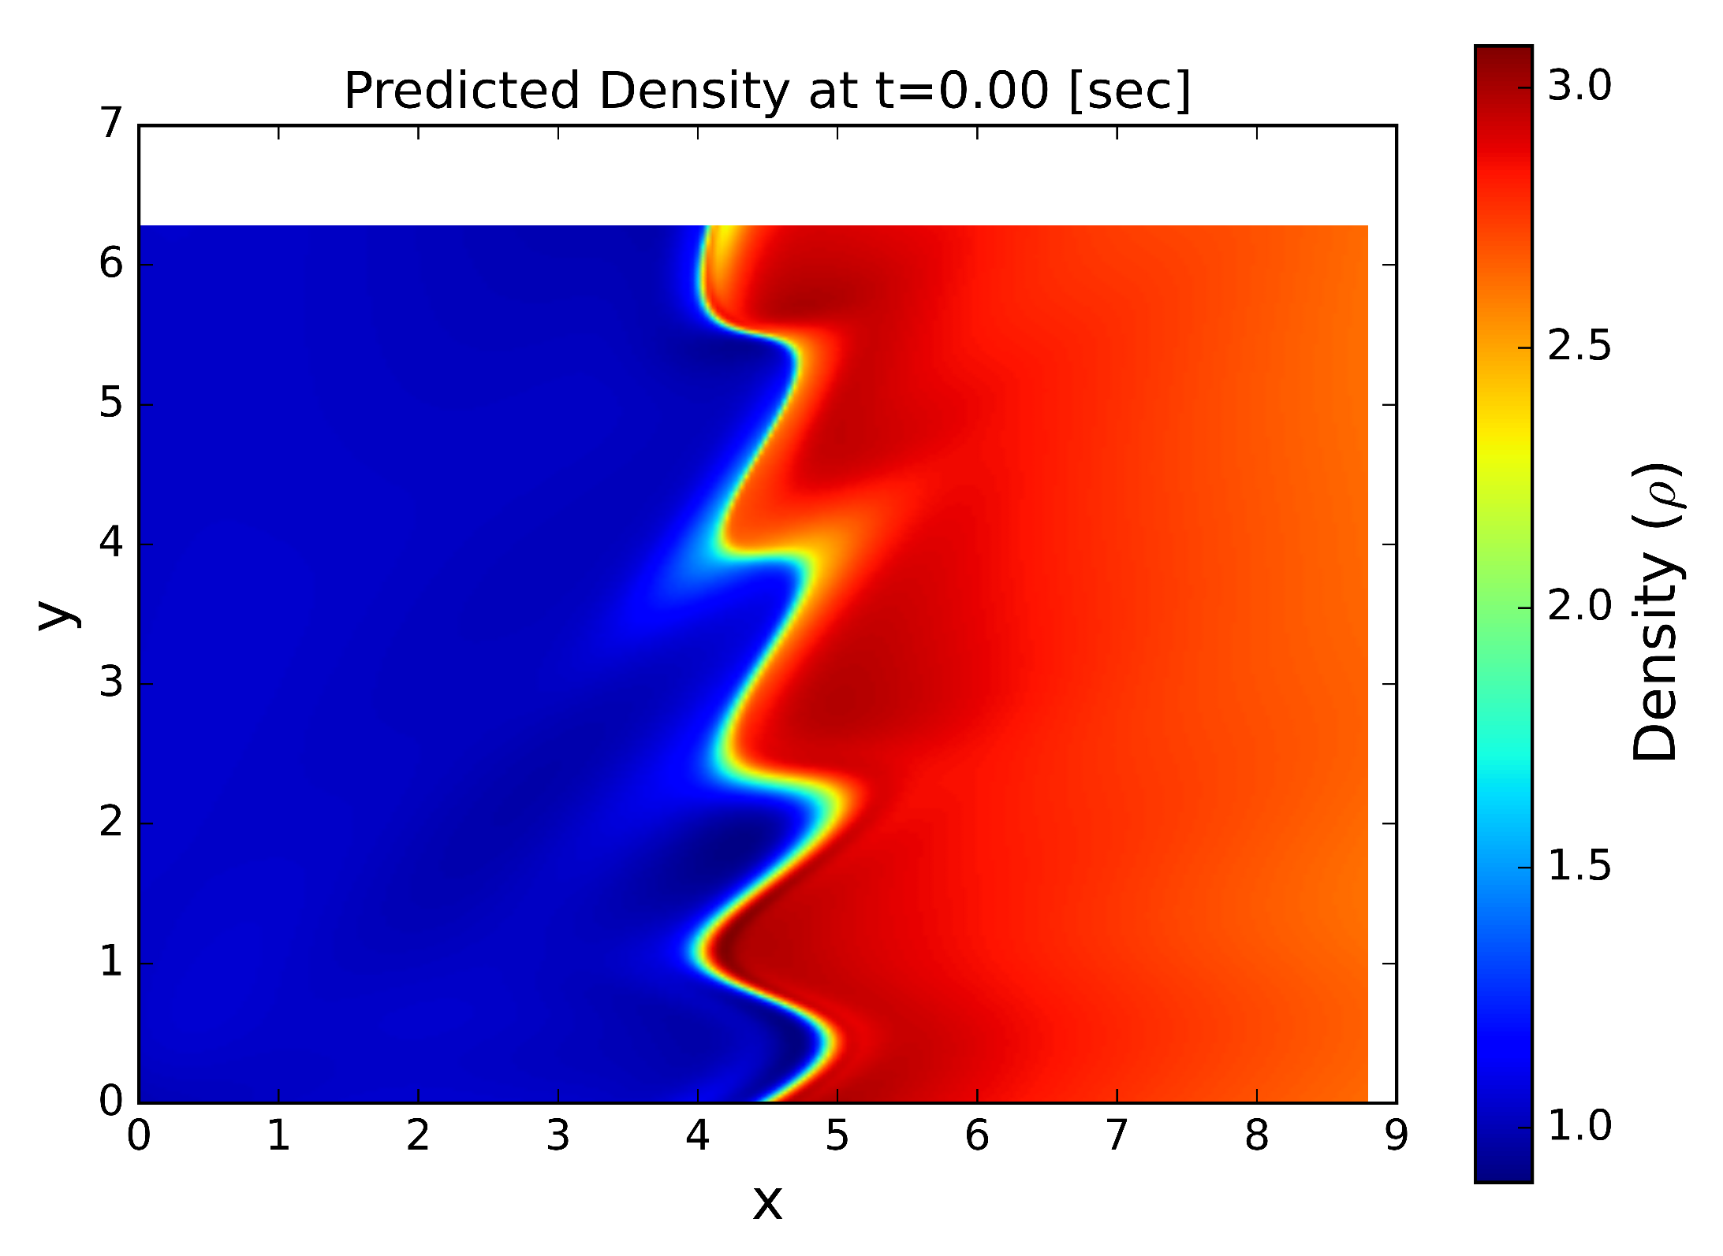
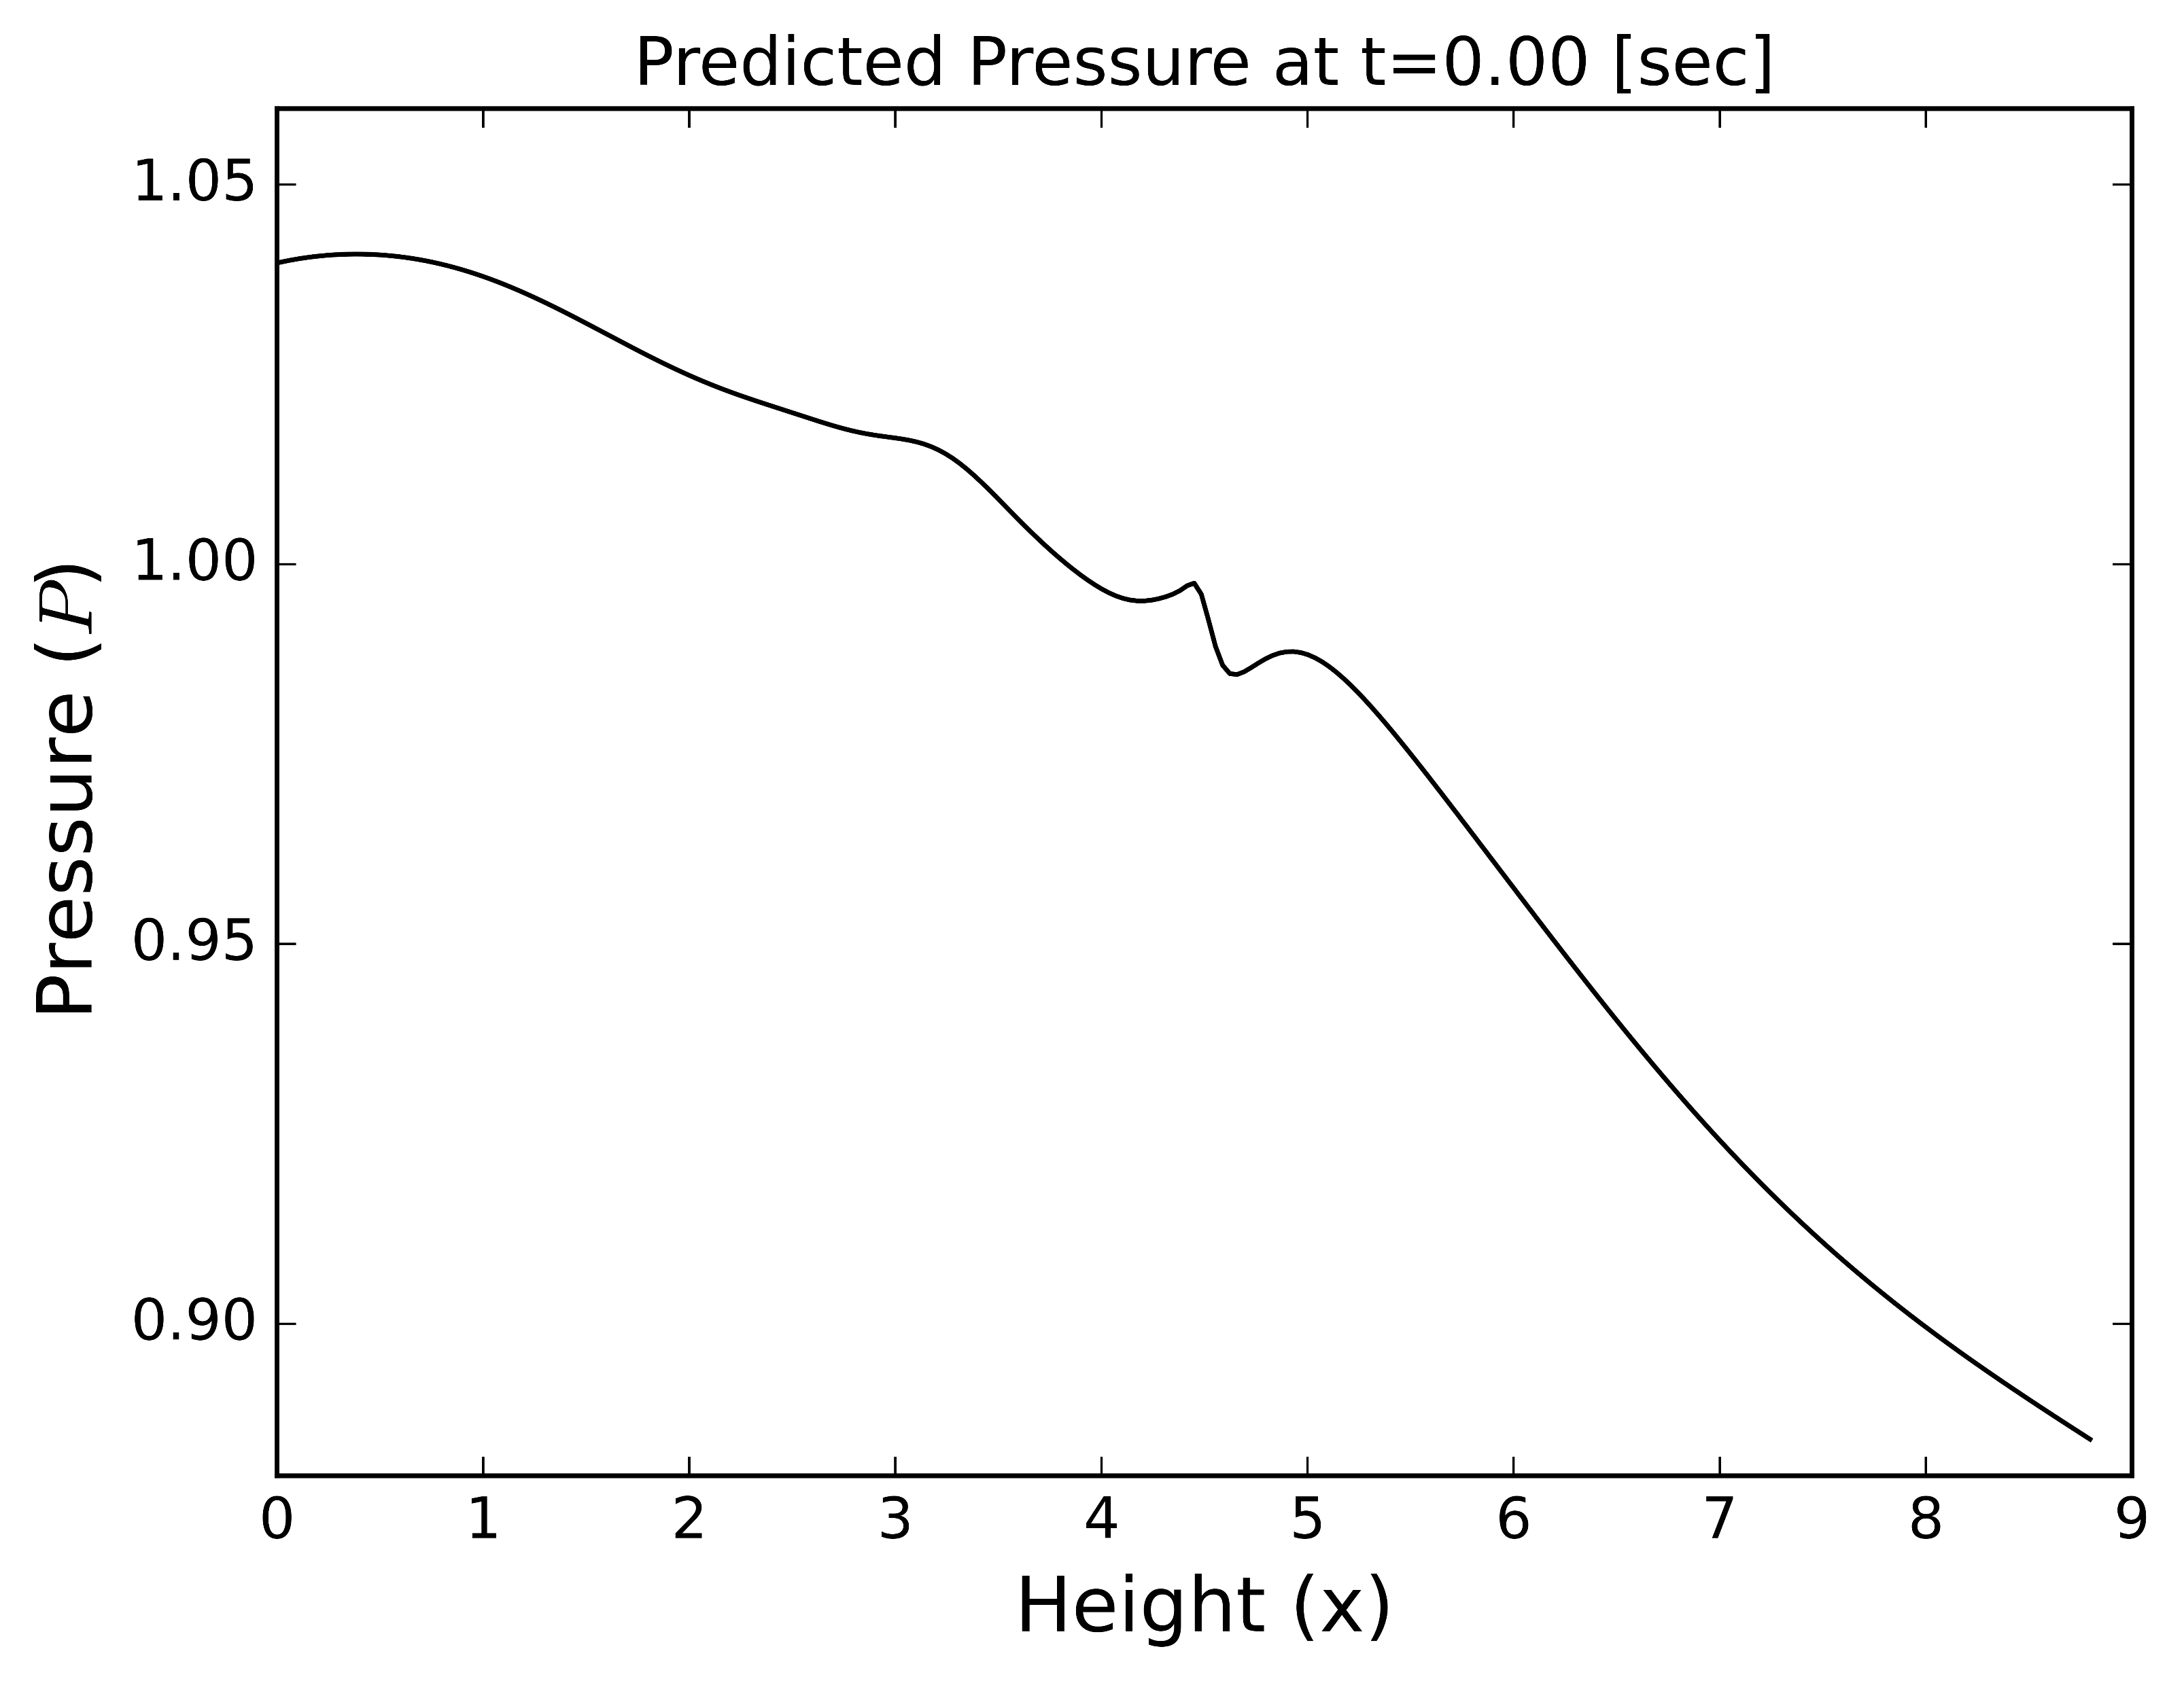
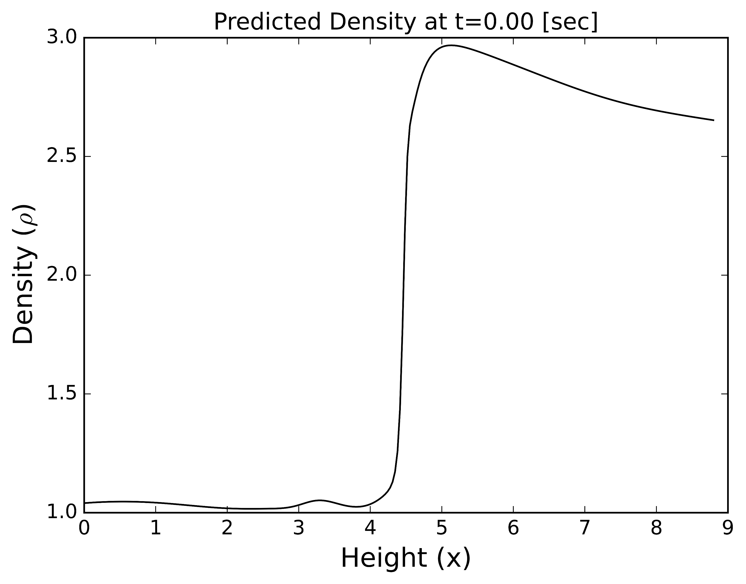
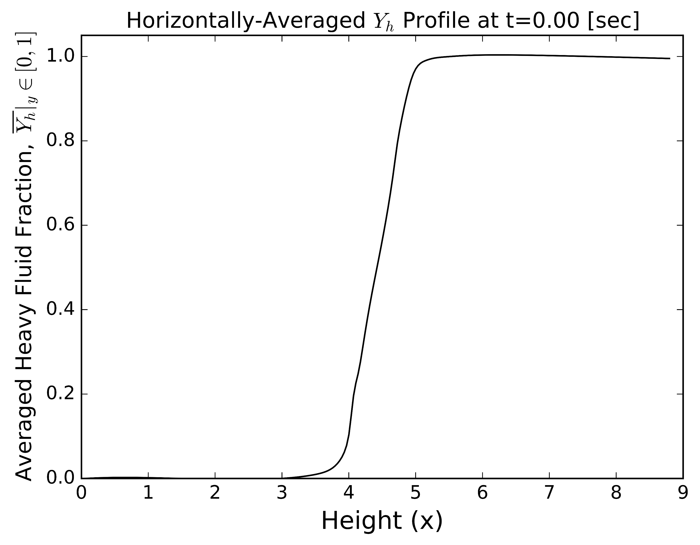
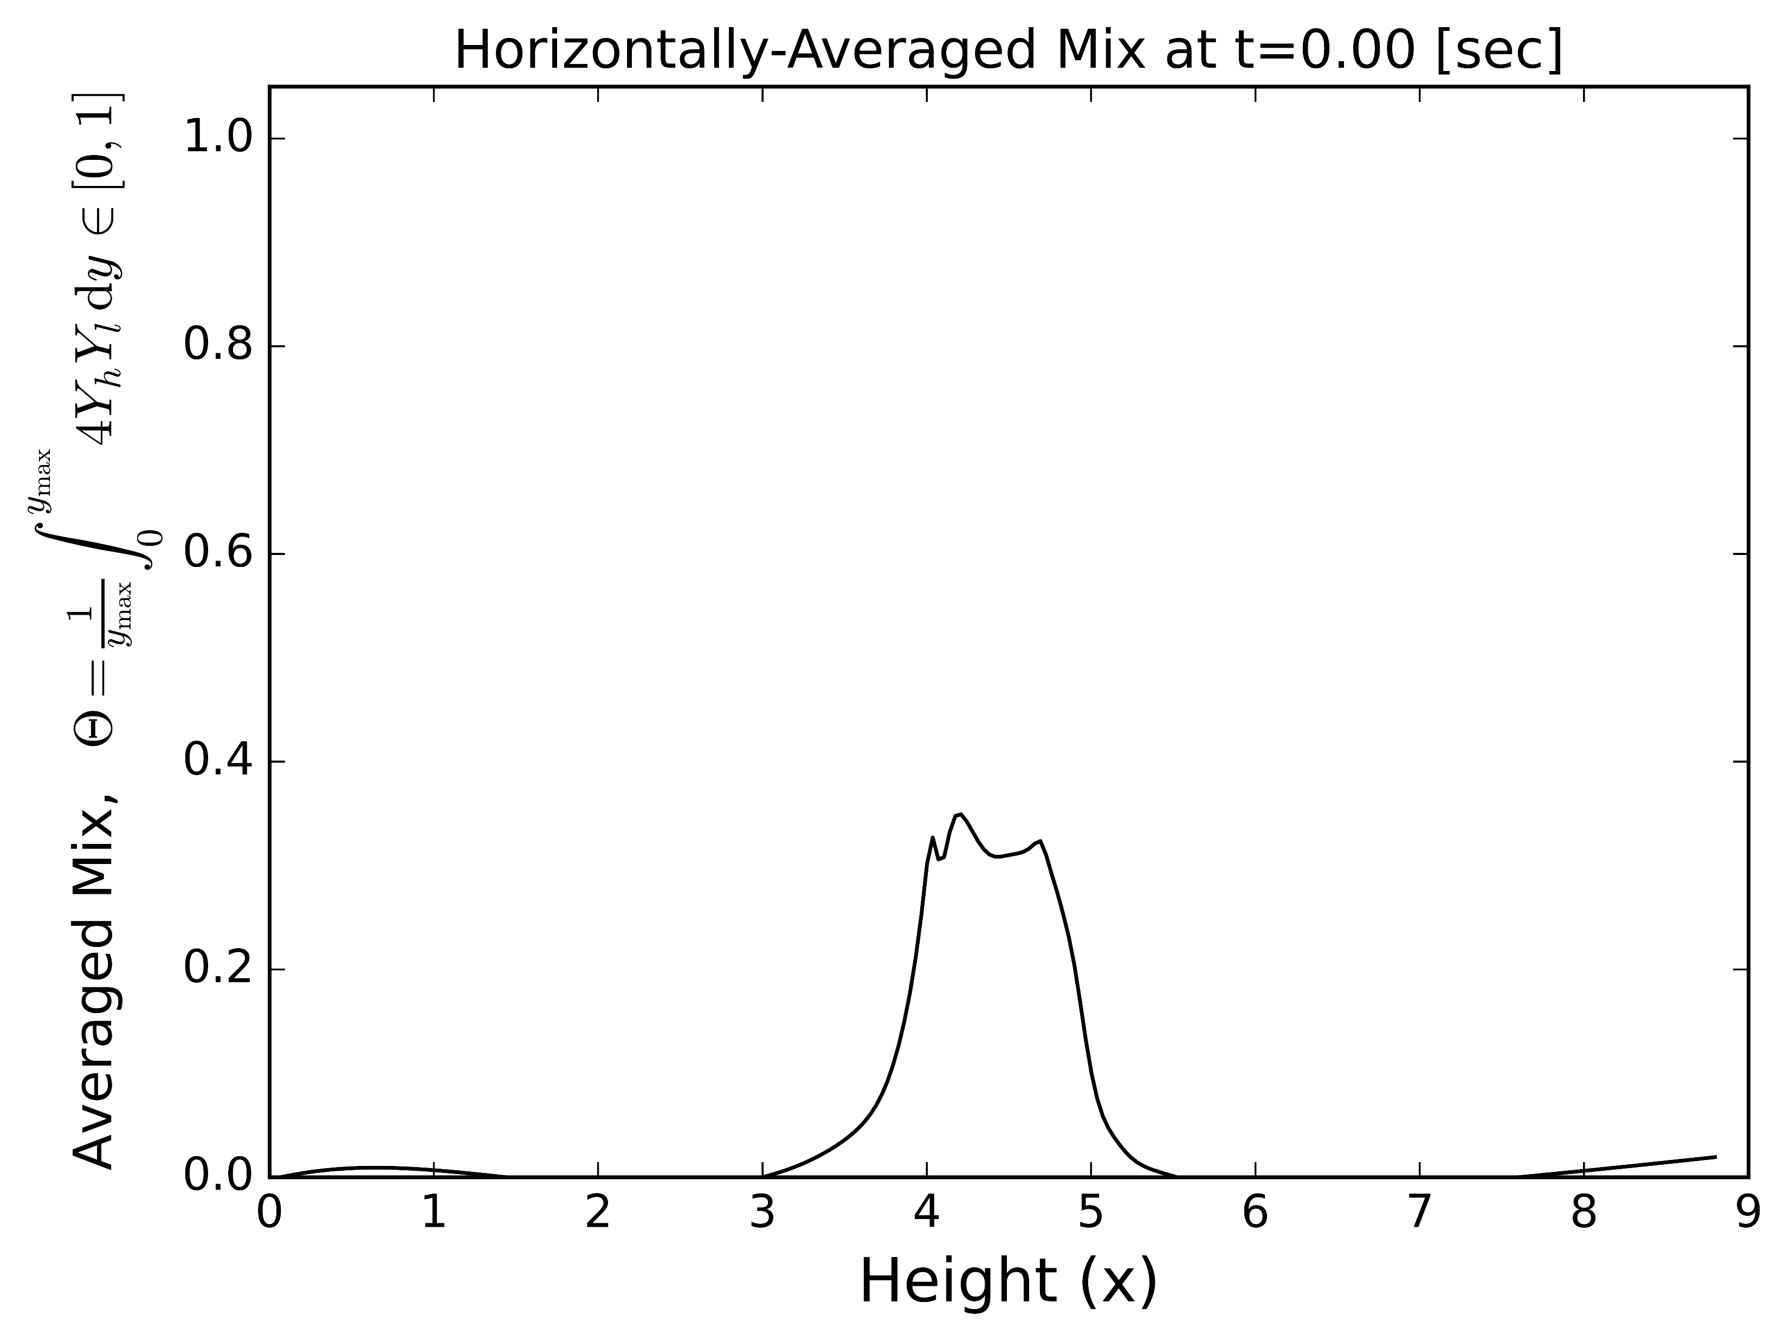
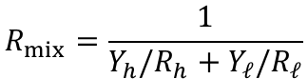
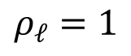

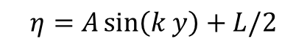
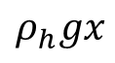
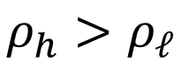
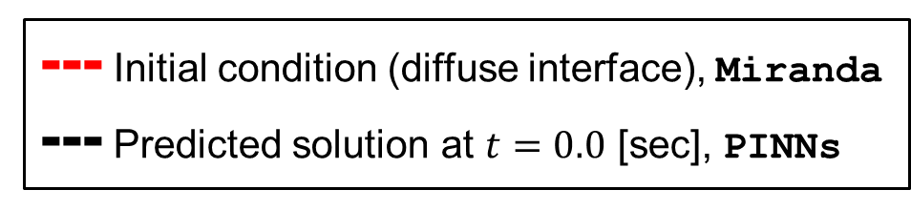

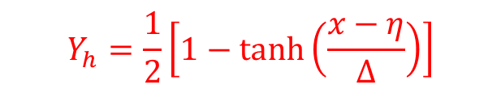
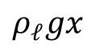
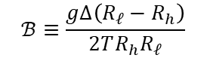
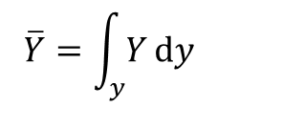
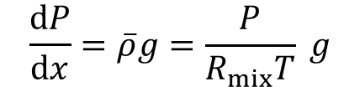

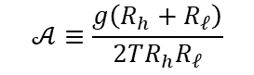
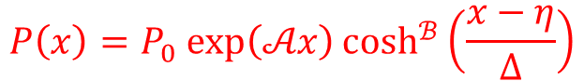
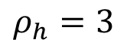

gravity, $g$
$$ρ_{h}=3$$
periodic
$$ρ_{h}>ρ_{ℓ}$$
wall
light
heavy
wall
2-D
$$N_{pts}=256$$
$$k=4$$
$$A_{t}=0.5$$
$$Re=∞$$
$$ρ_{ℓ}=1$$
periodic
--- Initial condition (diffuse interface), Miranda
--- Predicted solution at $t=0.0$ [sec], PINNs
$$P\left(x\right)=P_{0} exp\left(𝒜x\right)\cosh^{ℬ}\left(\frac{x−η}{Δ}\right)$$
$$ρ_{h}gx$$
$$𝒜≡\frac{g\left(R_{h}+R_{ℓ}\right)}{2TR_{h}R_{ℓ}}$$
$$ℬ≡\frac{gΔ\left(R_{ℓ}−R_{h}\right)}{2TR_{h}R_{ℓ}}$$
$$\frac{dP}{dx}=\overline{ρ}g=\frac{P}{R_{mix}T} g$$
$$ρ_{ℓ}gx$$
$$R_{mix}=\frac{1}{Y_{h}/R_{h}+Y_{ℓ}/R_{ℓ}}$$
$$Y_{h}=\frac{1}{2}\left[1−tanh\left(\frac{x−η}{Δ}\right)\right]$$
$$Y_{ℓ}=1−Y_{h}$$
$$η=A\sin\left(k y\right)+L/2$$
$$Δ=4⋅L/N_{pts}$$
$$\overline{Y}=\int_{y}{Y}dy$$

Slide 2
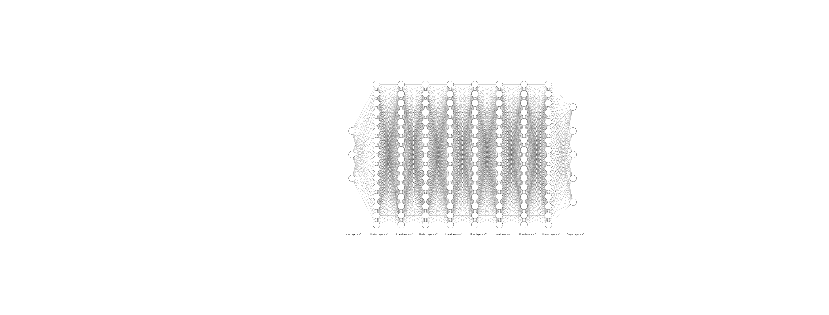
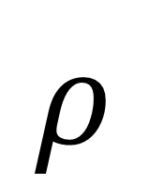
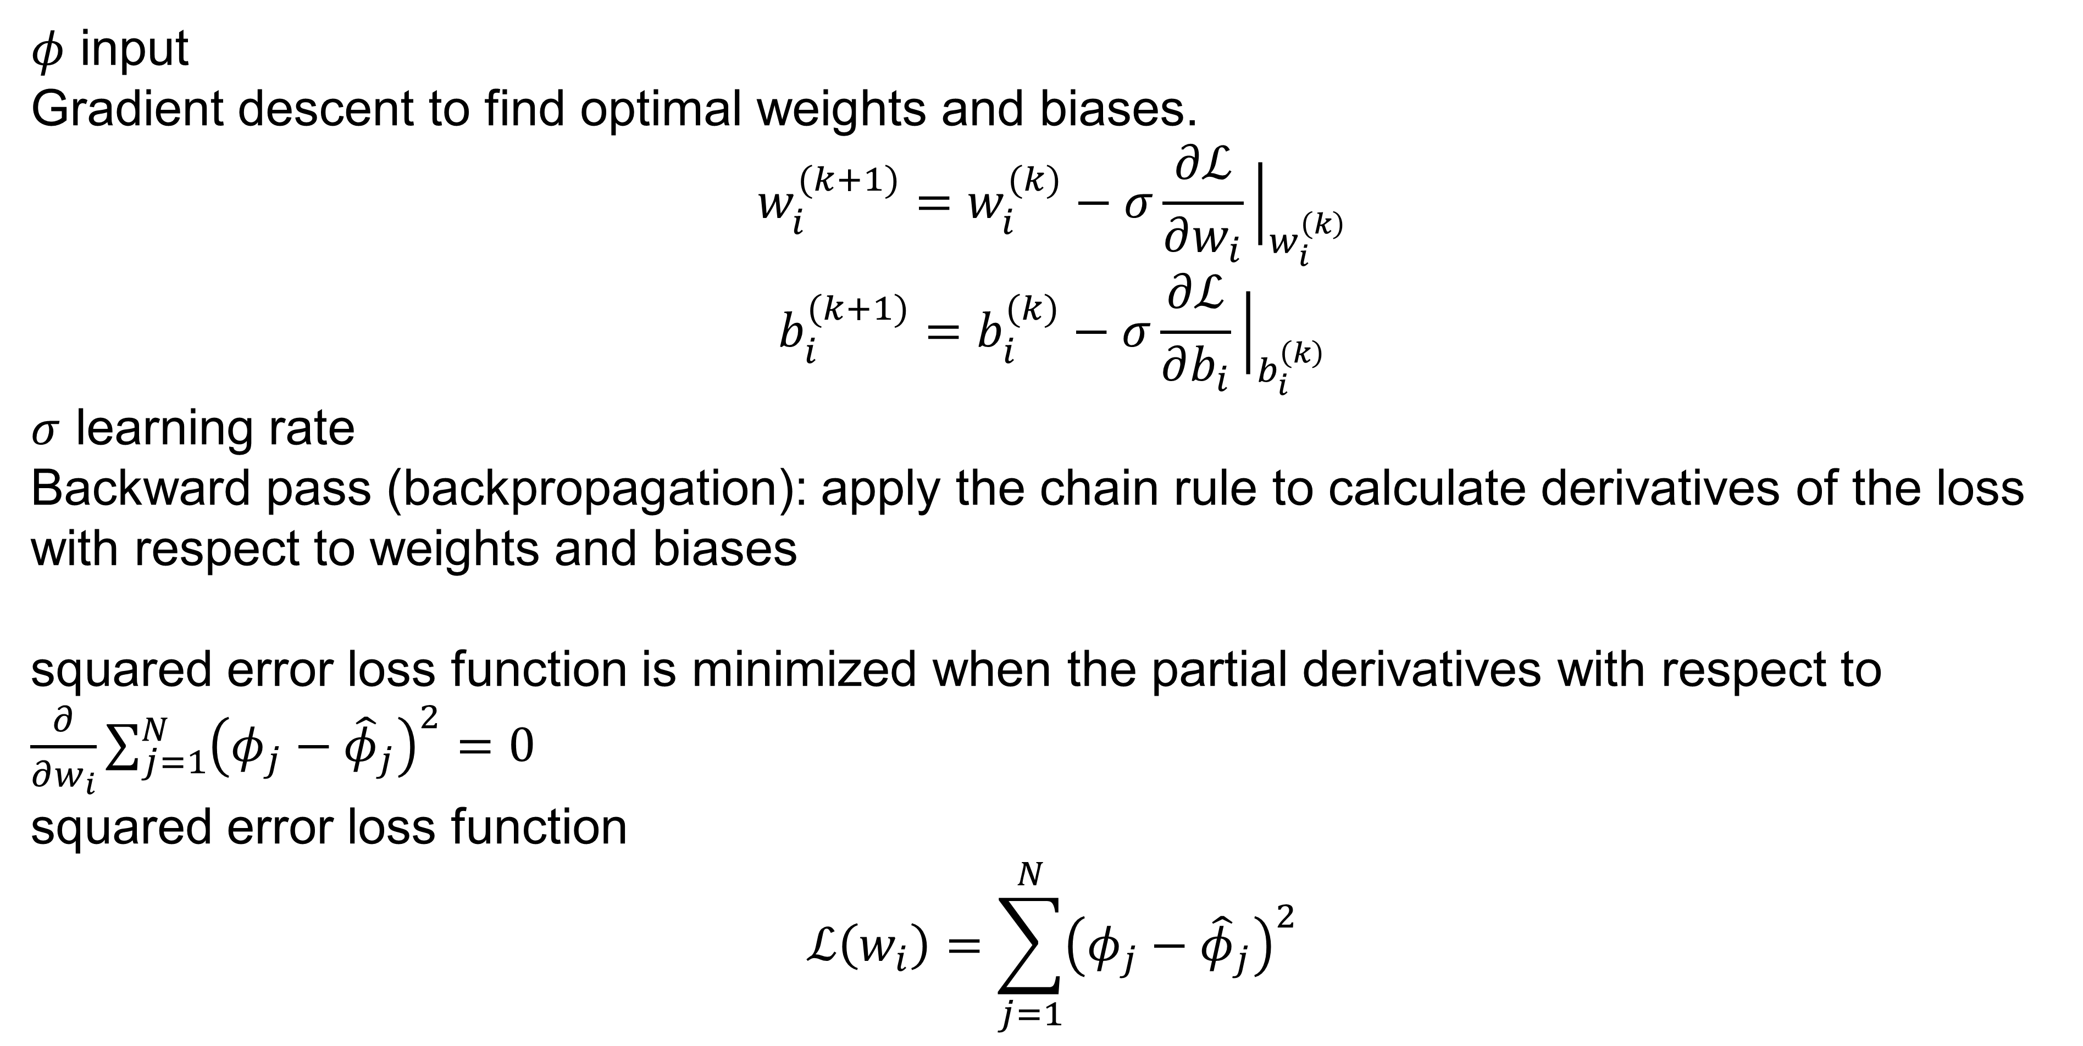

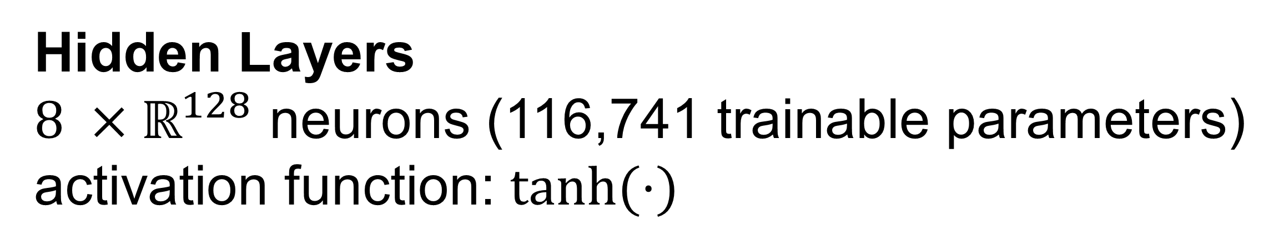

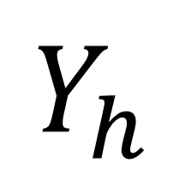
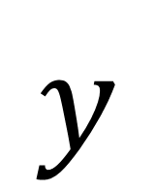
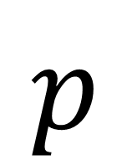


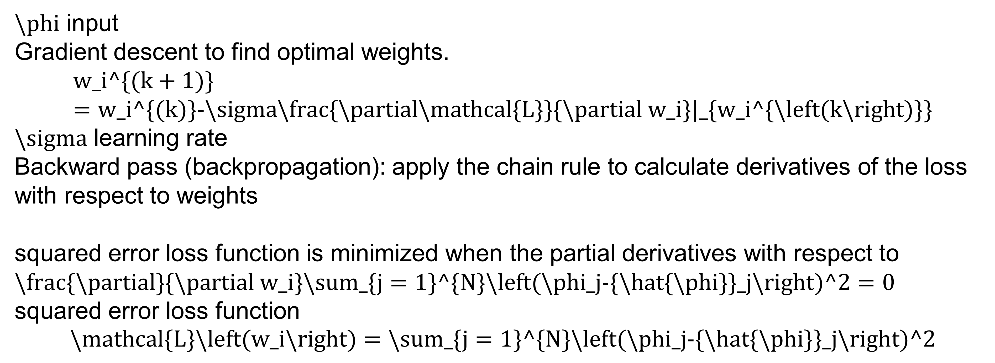
$$ρ$$
$$x$$
$$u$$
$$y$$
$$v$$
$$t$$
$$p$$
$$Y_{h}$$
Input Layer
Output Layer
Hidden Layers
$8 ×ℝ^{128}$ neurons (116,741 trainable parameters)
activation function: $\tanh{(⋅)}$
$φ$ input
Gradient descent to find optimal weights and biases.
$$w_{i}^{(k+1)}=w_{i}^{(k)}−σ\frac{∂ℒ}{∂w_{i}}{\left.​\right|}_{w_{i}^{\left(k\right)}}$$
$$b_{i}^{(k+1)}=b_{i}^{(k)}−σ\frac{∂ℒ}{∂b_{i}}{\left.​\right|}_{b_{i}^{\left(k\right)}}$$
$σ$ learning rate
Backward pass (backpropagation): apply the chain rule to calculate derivatives of the loss with respect to weights and biases
squared error loss function is minimized when the partial derivatives with respect to $\frac{∂}{∂w_{i}}\sum_{j=1}^{N}{{\left(φ_{j}−{\hat{φ}}_{j}\right)}^{2}}=0$
squared error loss function
$$ℒ\left(w_{i}\right)=\sum_{j=1}^{N}{{\left(φ_{j}−{\hat{φ}}_{j}\right)}^{2}}$$
$\backslash phi$ input
Gradient descent to find optimal weights.
$$w_i^\{(k+1)\}=w_i^\{(k)\}−\backslash sigma\backslash frac\{\backslash partial\backslash mathcal\{L\}\}\{\backslash partial w_i\}|_\{w_i^\{\backslash left(k\backslash right)\}\}$$
$\backslash sigma$ learning rate
Backward pass (backpropagation): apply the chain rule to calculate derivatives of the loss with respect to weights
squared error loss function is minimized when the partial derivatives with respect to $\backslash frac\{\backslash partial\}\{\backslash partial w_i\}\backslash sum_\{j=1\}^\{N\}\backslash left(\backslash phi_j−\{\backslash hat\{\backslash phi\}\}_j\backslash right)^2=0$
squared error loss function
$$\backslash mathcal\{L\}\backslash left(w_i\backslash right)=\backslash sum_\{j=1\}^\{N\}\backslash left(\backslash phi_j−\{\backslash hat\{\backslash phi\}\}_j\backslash right)^2$$

Slide 3
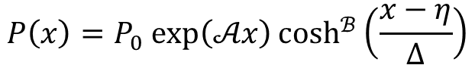
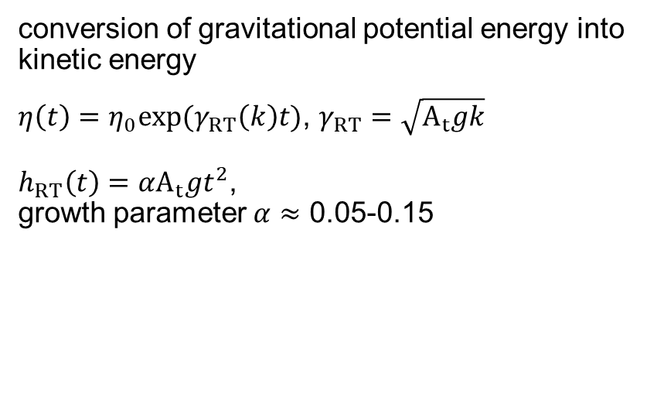
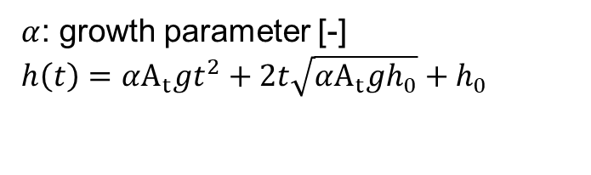
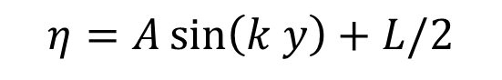
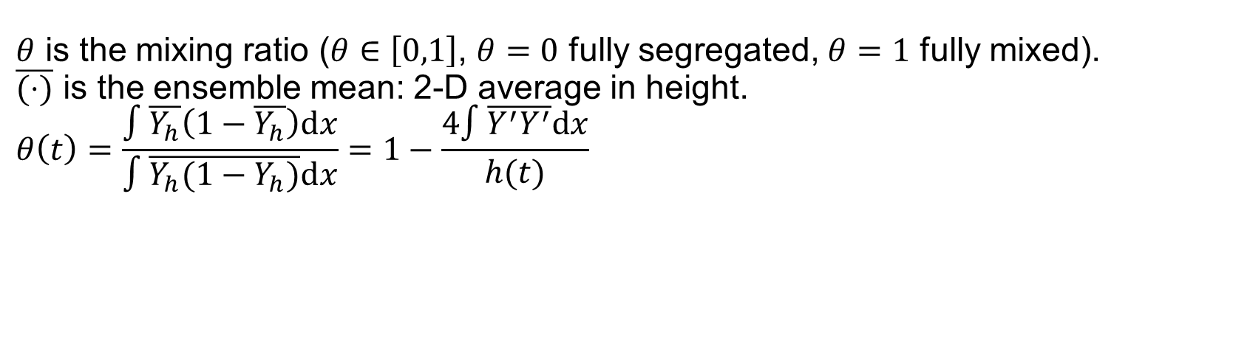
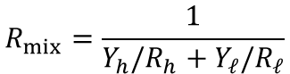
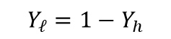
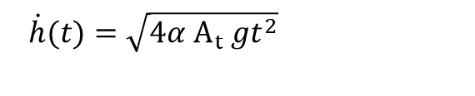
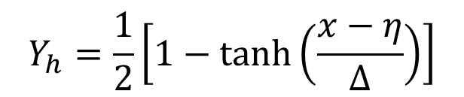
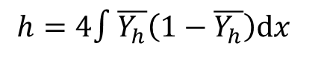
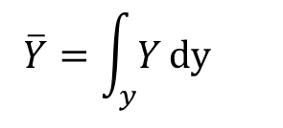
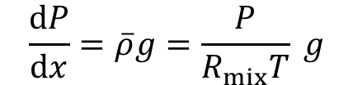
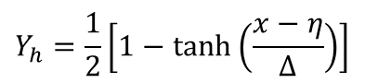

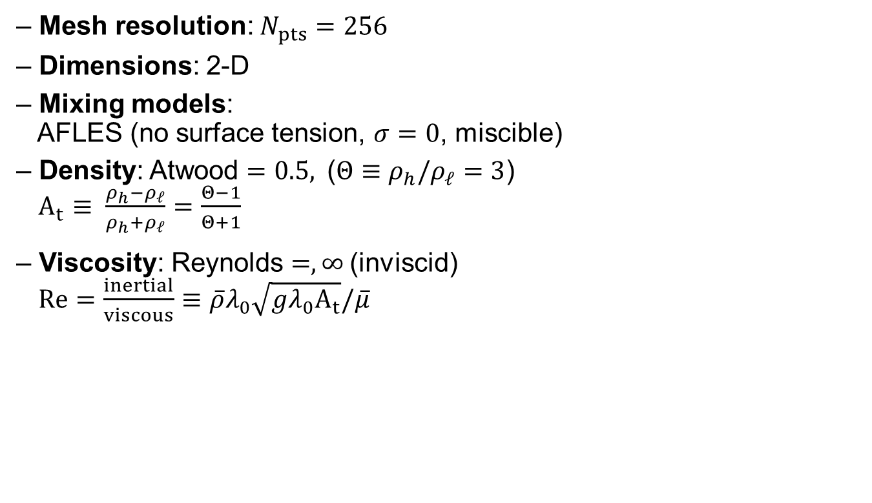
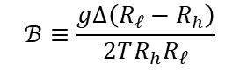
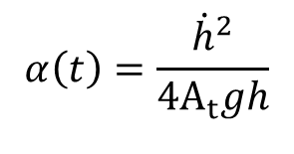

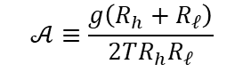
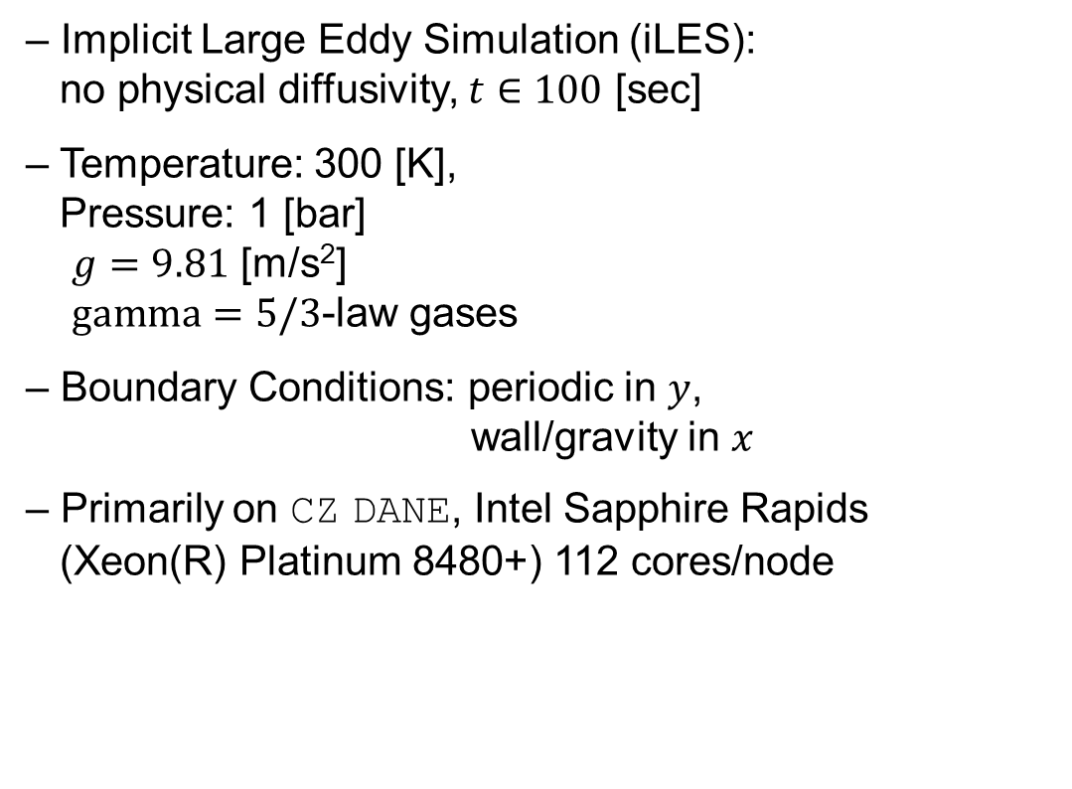
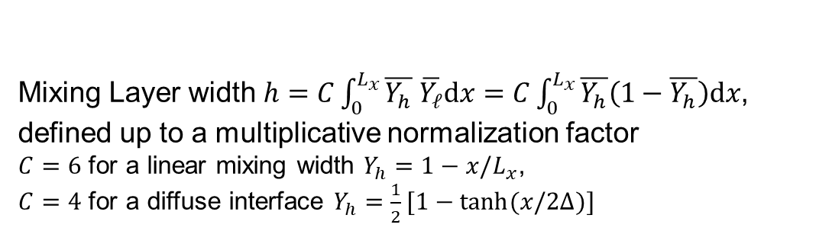
$$P\left(x\right)=P_{0} exp\left(𝒜x\right)\cosh^{ℬ}\left(\frac{x−η}{Δ}\right)$$
conversion of gravitational potential energy into kinetic energy
$η\left(t\right)=η_{0}exp⁡(γ_{RT}\left(k\right)t)$, $γ_{RT}=\sqrt{A_{t}gk}$
$h_{RT}\left(t\right)=αA_{t}gt^{2}$,
growth parameter $α≈$ 0.05-0.15
First deriving hydrostatic equilibrium throughout the domain with a diffuse interface:
$$𝒜≡\frac{g\left(R_{h}+R_{ℓ}\right)}{2TR_{h}R_{ℓ}}$$
$$ℬ≡\frac{gΔ\left(R_{ℓ}−R_{h}\right)}{2TR_{h}R_{ℓ}}$$
$$\frac{dP}{dx}=\overline{ρ}g=\frac{P}{R_{mix}T} g$$
$$R_{mix}=\frac{1}{Y_{h}/R_{h}+Y_{ℓ}/R_{ℓ}}$$
$$Y_{h}=\frac{1}{2}\left[1−tanh\left(\frac{x−η}{Δ}\right)\right]$$
$$h=4∫\overline{Y_{h}}\left(1−\overline{Y_{h}}\right)dx$$
$$Y_{ℓ}=1−Y_{h}$$
$$\overline{Y}=\int_{y}{Y}dy$$
$α$: growth parameter [-]
$$h\left(t\right)=αA_{t}gt^{2}+2t\sqrt{αA_{t}gh_{0}}+h_{0}$$
– Implicit Large Eddy Simulation (iLES):
no physical diffusivity, $t∈100$ [sec]
– Temperature: 300 [K],
Pressure: 1 [bar]
$g=9.81$ [m/s²]
$gamma=5/3$-law gases
– Boundary Conditions: periodic in $y$,
wall/gravity in $x$
– Primarily on CZ DANE, Intel Sapphire Rapids
(Xeon(R) Platinum 8480+) 112 cores/node
$\dot{h}(t)=\sqrt{4α{ A}_{t} gt^{2}}$
$$α\left(t\right)=\frac{{\dot{h}}^{2}}{4A_{t}gh}$$
$θ$ is the mixing ratio ($θ∈\left[0,1\right]$, $θ=0$ fully segregated, $θ=1$ fully mixed).
$\overline{(⋅)}$ is the ensemble mean: 2-D average in height.
$$θ\left(t\right)=\frac{∫\overline{Y_{h}}\left(1−\overline{Y_{h}}\right)dx}{∫\overline{Y_{h}(1−Y_{h})}dx}=1−\frac{4∫\overline{Y^{′}Y^{′}}dx}{h(t)}$$
$$Y_{h}=\frac{1}{2}\left[1−tanh\left(\frac{x−η}{Δ}\right)\right]$$
Mixing Layer width $h=C\int_{0}^{L_{x}}{\overline{Y_{h}} \overline{Y_{ℓ}}dx}=C\int_{0}^{L_{x}}{\overline{Y_{h}}\left(1−\overline{Y_{h}}\right)dx}$,
defined up to a multiplicative normalization factor
$C=6$ for a linear mixing width $Y_{h}=1−x/L_{x}$,
$C=4$ for a diffuse interface $Y_{h}=\frac{1}{2}[1−\tanh{(x/2Δ)]}$
$$Y_{ℓ}=1−Y_{h}$$
$$Δ=4⋅L/N_{pts}$$
$$η=A\sin\left(k y\right)+L/2$$
– Mesh resolution: $N_{pts}=256$
– Dimensions: 2-D
– Mixing models:
AFLES (no surface tension, $σ=0$, miscible)
– Density: Atwood $=0.5,$($Θ≡ρ_{h}/ρ_{ℓ}=3$)
$A_{t}≡ \frac{ρ_{h}−ρ_{ℓ}}{ρ_{h}+ρ_{ℓ}}=\frac{Θ−1}{Θ+1}$
– Viscosity: Reynolds $=,∞$(inviscid)
$Re=\frac{inertial}{viscous}≡\overline{ρ}λ_{0}\sqrt{gλ_{0}A_{t}}/\overline{μ}$

Slide 4
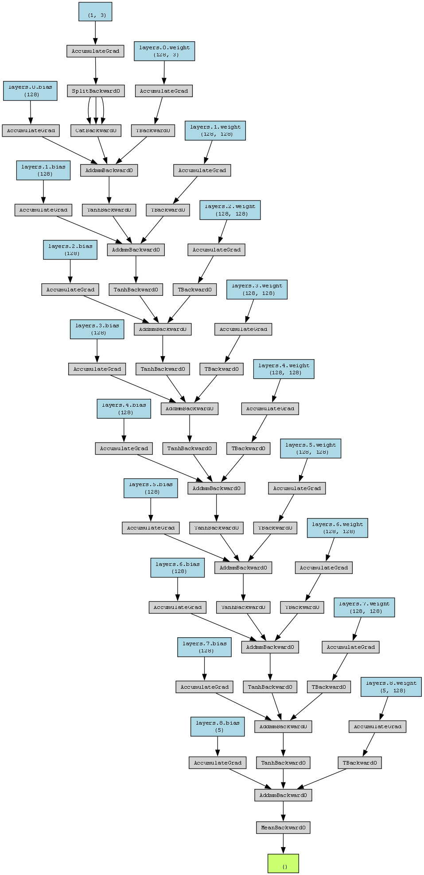
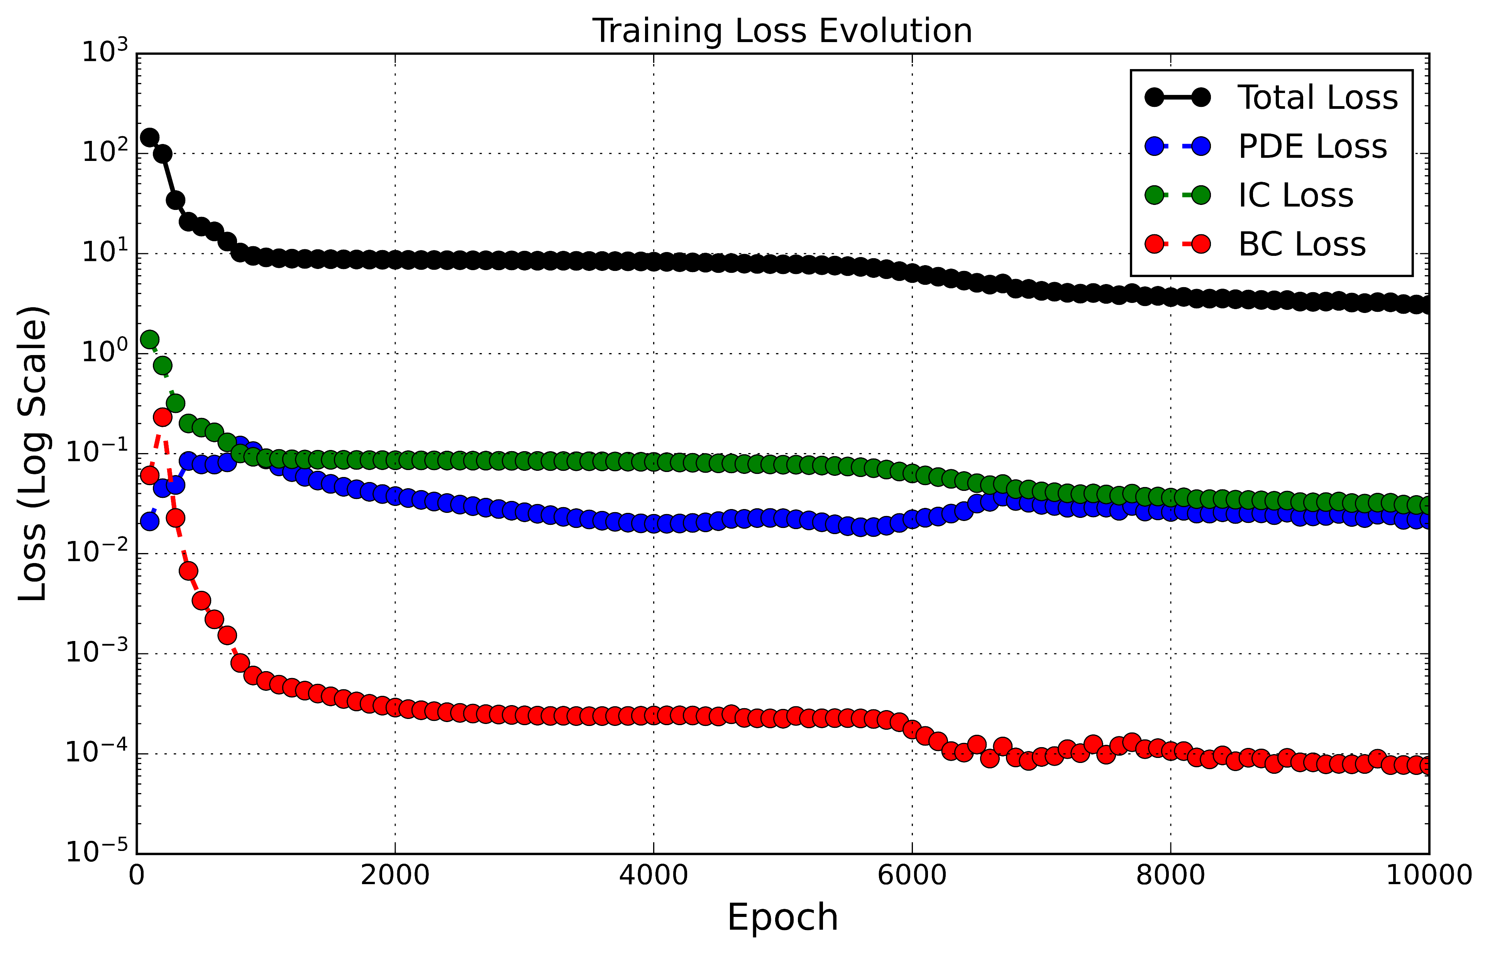
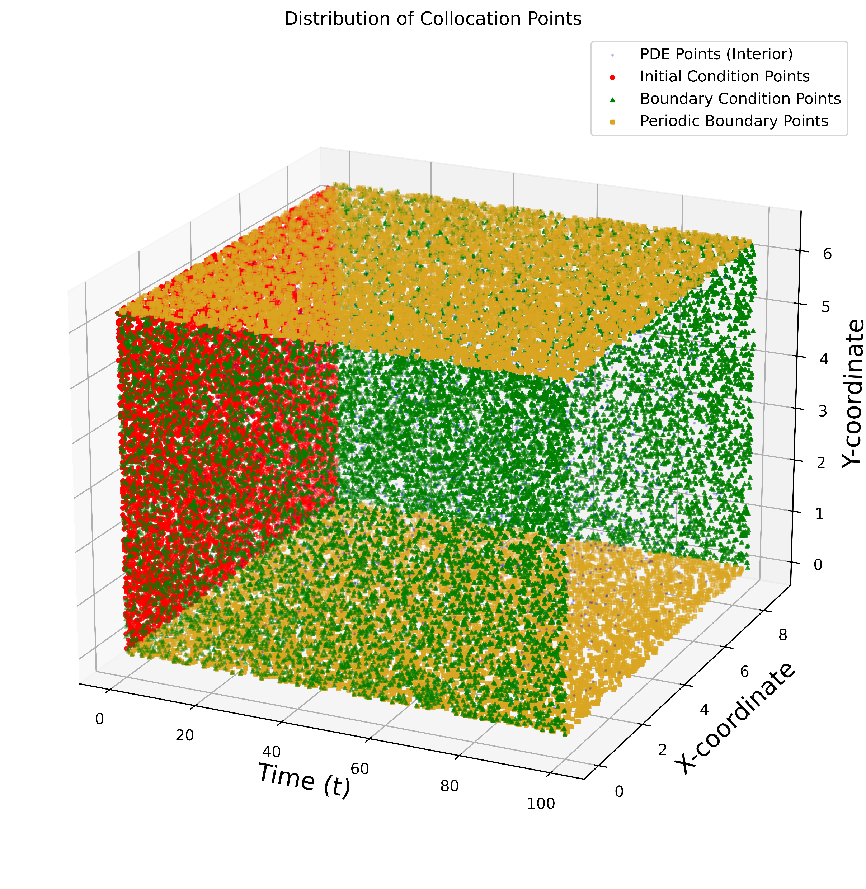





Slide 5






$$h=4∫\overline{Y_{h}}\left(1−\overline{Y_{h}}\right)dx$$
$$\overline{Y}=\int_{y}{Y}dy$$
Transition to Turbulence
Self-similar Growth

Slide 6





































$t=0$ [sec]
$t=10$ [sec]
$t=20$ [sec]
$t=30$ [sec]
$t=40$ [sec]
$t=50$ [sec]
2-D
$$N_{pts}=256$$
$$k=4$$
$$A_{t}=0.5$$
$$Re=∞$$
$t=60$ [sec]
$t=70$ [sec]
$t=80$ [sec]
$t=90$ [sec]
$t=100$ [sec]
$t=$ end
time
$$error=dP/dx−\overline{ρ}g$$
--- Initial condition (diffuse interface), Miranda
--- Instantaneous averaged profile every $10$ [sec], Miranda
--- Predicted solution at $t=100$ [sec], PINNs
time
time

